Slide 1


INTELLIGENT CACHING IN EDGE NETWORKS
PROJECT ID = 538
8 Credits
Notes:
FTP file transfer

Slide 2



Team composition
SL. NO | Name of the student | SRN | PHOTO
1. | Shamitha. S | PES1201701655
2. | Astha Singh | PES1201701156
3. | Segu Prathyusha | PES1201701159
Guide : Dr. Anuradha. M, Chairperson for Department of Electronics and Communication Engineering

Slide 3
Contents
PROBLEM STATEMENT
LITERATURE SURVEY
OBJECTIVE
DATASET AND PRE-PROCESSING
DATASET VISUALIZATION
METHODOLOGY
ALGORITHMS
RESULT
CONCLUSION
GANTT CHART
REFERENCES
Notes:
team,content,problem satatment,motivation,methodolgy,blockdiagram-explanation,working principal,delevirables,cocclusion,future work,timeline ,references

Slide 4
Problem Statement
Caching is done to store any data so that future requests for that data is served faster.
Caching of web pages, media and files by making use of machine learning techniques to increase the hit rate of the cache.

Slide 5
Literature Review
Machine Learning for Network Edge Caching in the Big Data Era
Optimizing LeCar and Convolutional Neural Network Approaches for Cache Replacement Policy
Content Popularity Prediction Towards Location-Aware Mobile Edge Caching
Intelligent Caching in Edge Networks
02/05/2021
Notes:
Unsupervised learning ( K-means clustering) is used to partition the user equipments (UE) in each cell into clusters .Deep Neural Network (DNN) istrained and it learns the optimal decisions with certain input parameters. After training, DNN predicts content for the users. Device to Device caching design is done based on the hit probability. Several transmit UE act as caches and several receive UE ask for data. Kullback-Leibler (KL) divergence is used to obtain the similarity which is the common interests over a large number of data items.
3rd : To fully exploit edge storage resources, the most popular contents should be identified and cached . .Popularity of a content depends on various factors.this paper focus more on popularity of content based on location. .A ridge regression based prediction algorithm is proposed to estimate the location feature vector in case of zero -mean noise. Theoretical analysis shows that it asymptotically approaches the optimal strategy in the long-term.H∞ based prediction algorithm when the noise is unknown, which is robust as long as the noise amplitude is finite.

Slide 6
Objective
Caching is done to store requests such as web pages, media, files so that the future requests can be served faster.
Caching is done to decrease load on core networks
Maximum utilization of the space and time.
We are aiming to implement our model in edge networks and near gateways router.

Slide 7
Dataset
The dataset was collected from Wireshark open source tool
The packets were captured over WLAN
Dataset consists of FTP and HTTP requests.
Notes:
DATASET UPDATION:
The dataset was collected from Wireshark open source tool over WLAN
Captured FTP request packets
Applying ML algorithms for huge files along with HTTP request packets to compensate the computational time and cost involved

Slide 8
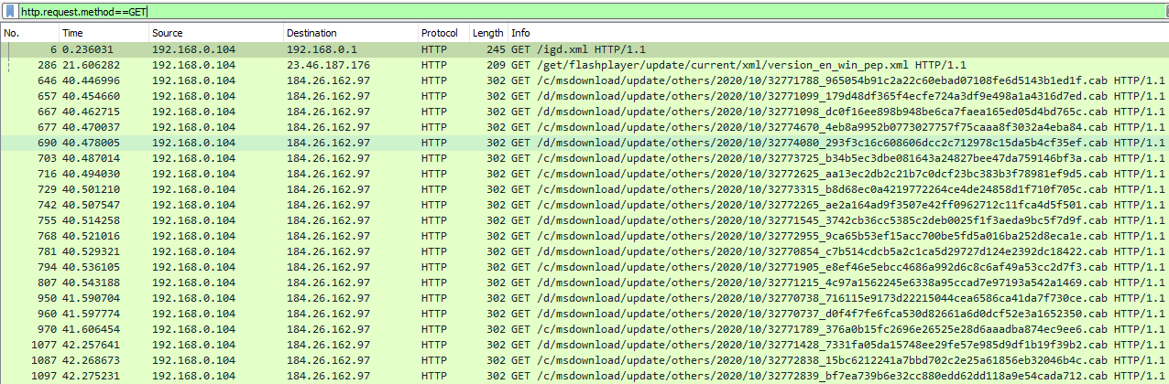
Captured Dataset
HTTP GET packets
Intelligent Caching in Edge Networks
02/05/2021

Slide 9
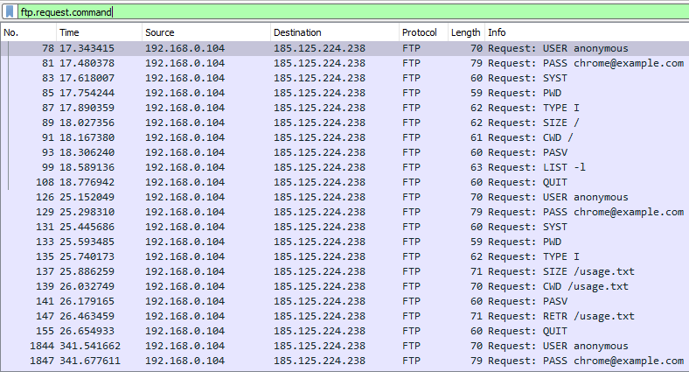
FTP Request packets

Slide 10
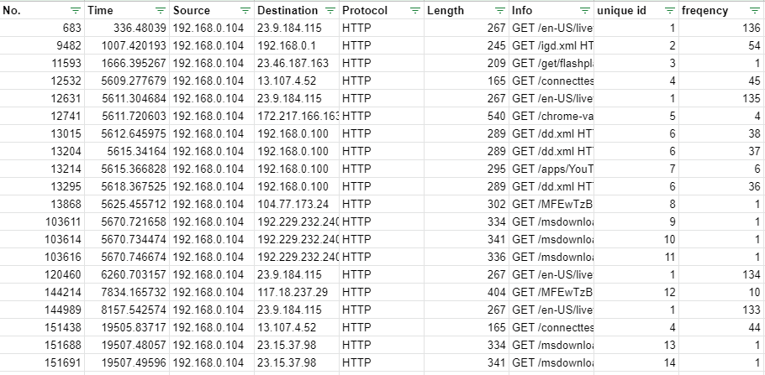
Pre-processed Dataset
Additional parameters added include: unique id and frequency

Slide 11
Dataset Visualization
3512 requests, 998 unique info labels
We are considering info, unique id, frequency and size as our parameters from the above dataset.
Frequencies have a mean of 3.8 and standard deviation of 23.198.
As info is of string type we have found unique id’s.

Slide 12
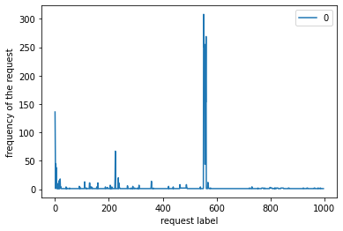
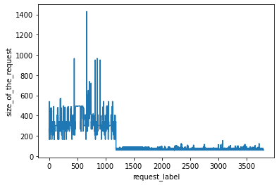
PLOTS
Frequency plot
Size plot

Slide 13
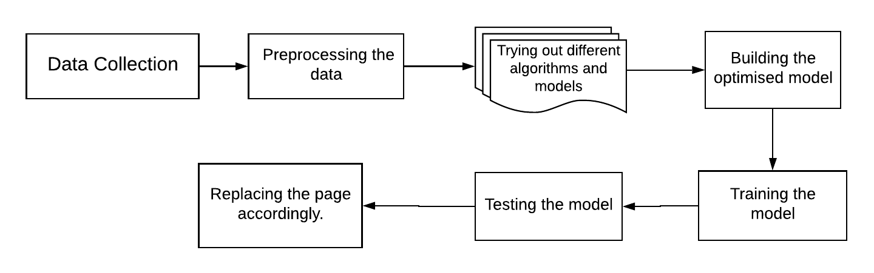
Methodology
Intelligent caching in edge networks
02/05/2021

Slide 14
Caching Algorithms
Least Recently Used (LRU)
In this algorithm in case of a cache miss, the page which has been least recently used will be replaced by the new page.
Least Frequently Used (LFU)
In this algorithm in case of a cache miss, the page which has been least frequently used will be replaced by the new page.
Notes:
It organizes items in order of use, allowing us to quickly identify which item hasn't been used for the longest amount of time.
In this algorithm in case of a cache miss, the page which has been least recently used will be replaced by the new page
In this we keep track of the number of times a block is referenced in memory and the one which has been least referenced is replaced. In this algorithm in case of a cache miss, the page which has been least frequently used will be replaced by the new page.
Drawback of LRU
It is vulnerable to sequential disk scan, such as when the sequential requested data size is larger than the cache size, LRU has no effect in the cache.
Drawback of LFU
This algorithm requires extra overhead to maintain the page number and corresponding frequency counts and also has the drawback of accumulating stale pages with past high-frequency counts.

Slide 15
3. Belady’s Optimal Replacement Policy (OPT)
OPT traces the future blocks that will be brought to cache in order to pick the best candidate to evict.
Used as performance benchmark for cache algorithms testing.
4. Adaptive Replacement Cache (ARC)
It keeps track of LRU, LFU and the evicted LRU and LFU. The relative size of LRU and LFU are self tuned.

Slide 16
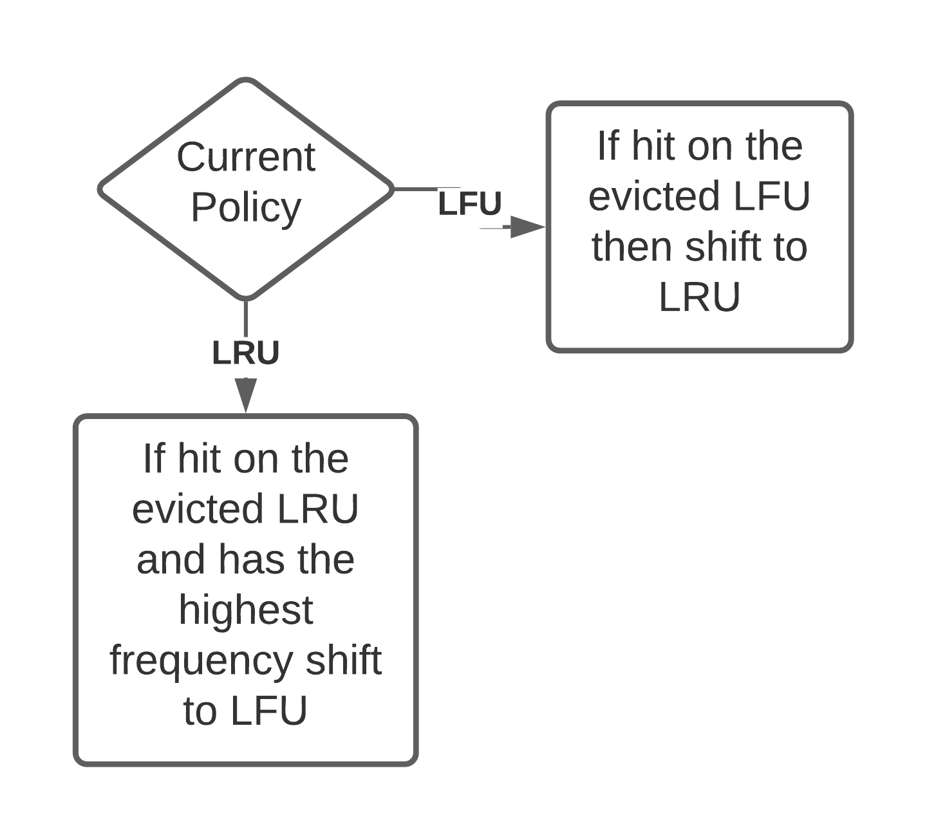
5. LeCar_Opt
Algorithm
Even here LRU, LFU and evicted LRU and LFU are kept in track.
Based on which queue the page is found, policy is chosen accordingly.
Possible shifts:
Shifting from LRU to LFU.
Shifting from LFU to LRU.

Slide 17
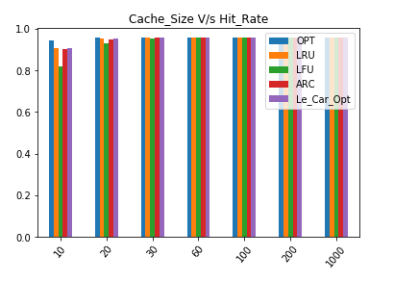
Results of Caching Algorithm
Notes:
When cache size is large all algorithms work equally
OPT gives us the maximum hit rate for all cache sizes
For small cache sizes, performance of Le_Car_Opt is best followed by LRU .
LFU is not preferred for small cache sizes
Cache Size

Slide 18
Multi Layer Perceptron (MLP)
Class of feedforward artificial neural network
MLP is implemented along with LRU and LFU to determine which block to replace.
Python pytorch library is used for coding.
Notes:
A multilayer perceptron (MLP) is a class of feedforward artificial neural network (ANN). ... An MLP consists of at least three layers of nodes: an input layer, a hidden layer and an output layer. Except for the input nodes, each node is a neuron that uses a nonlinear activation function.MLP utilizes a supervised learning technique called backpropagation for training.
Function is called with dataset,cache_size and mlp model
cache size tested 10,20,50,100 and 20 gave best result
LRU is implemented as a stack in which the top of the stack has the most recent block address always .
LFU_Dict is implemented as a dictionary in which key = block address and value = is the number of times it's occurring
eviction array maintains the address which can be replaced
delete and add in LRU_Queue so that the block which is recently visited is at the beginning of the LRU_Queue
Cache_size used = 20
Algorithm :
Run a for loop for all the blocks in the dataset
Update the count of LFU_Dictionary for that block
If block is present in cache:
> Increment hit and delete and add in LRU_stack
If block is not present in cache:
> Increment miss
> If cache has place: add the block in cache and delete and add in LRU_stack
> If cache is full :
>>Generate a matrix using the frequency of blocks,occurance of block and the current contents of the cache
>>Run the MLP model with this matrix
>>It will return matrix with probability that the block will be called again in future
>>Index value is taken of the block which has the least probability
>>That block is deleted from LRU_stack
>>Put new block in that index of cache and add it in LRU_stack
calculate and return hit rate
2 convolution 2D layer and a linear and relu layer
A matrix is generated as:
1st column = lfu =frequency of blocks is taken and normalised from lfu
2nd column=lru=index value of occurance of block is taken and normalised from lru
3rd column =cache=cache index are taken and normalised
lower value = less probability of calling it again in future
Index value is taken of the block which has the least probability that it will be called in future
OUTPUT : 0.9029126213592233
hit 186 miss 20
cache ['Destination', '172.217.174.78', '192.168.0.104', '124.40.244.44', '192.168.0.1', '8.241.150.126', '184.26.162.16', '184.26.162.25', '23.9.184.115', '192.168.0.100', '8.241.128.126', '13.107.4.52', '192.229.232.240', '151.139.128.14', '117.18.237.29', '96.7.111.240', '216.58.203.14', '124.40.244.45', '23.46.187.176', '184.26.162.97']

Slide 19
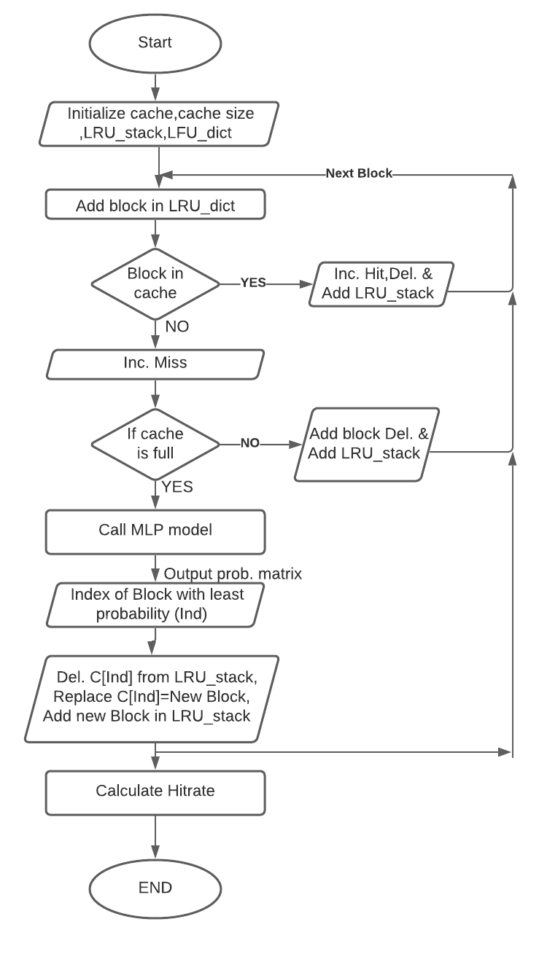
Notes:
Cache_size used = 20
Algorithm :
Run a for loop for all the blocks in the dataset
Update the count of LFU_Dictionary for that block
If block is present in cache:
Increment hit and delete and add in LRU_stack
If block is not present in cache:
Increment miss
If cache has place: add the block in cache and delete and add in LRU_stack
If cache is full :
Generate a matrix using the frequency of blocks,occurance of block and the current contents of the cache
Run the MLP model with this matrix
It will return matrix with probability that the block will be called again in future
Index value is taken of the block which has the least probability
That block is deleted from LRU_stack
Put new block in that index of cache and add it in LRU_stack
calculate and return hit rate
OUTPUT of MLP Model : Hit rate = 0.9029126213592233

Slide 20
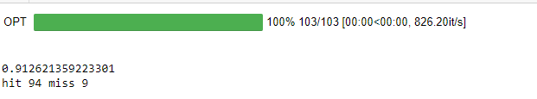
Output of MLP
From the output we see that the MLP model gives a very high hit rate. Such a high hit rate is there because the size of the dataset is comparably small.

Slide 21

Multiple Regression
Linear Regression is a supervised machine learning algorithm where the predicted output depend only on one input .
Multiple regression is like linear regression, but with more than one independent value, in this we try to predict a value based on two or more variables.
In the above equations :
y=the target variable
x=the input variable(x1,x2,.....xn in case of multiple regression)
b0=the intercept value
b1,b2b….bn=coefficient describing the relationship between a combination of input variable and the target variable
Notes:
Linear Regression is a supervised machine learning algorithm where the predicted output depend on only on input .But since we have more than one input on which our output depends .We went for multiple regression .
a model that assumes a linear relationship between the input variables (x) and the single output variable .
this is used to examine the relationships between the various input variables and output variable .
It is a kind of y=mx+c relation where output depends only on one parameter .
We did this to find the relation between the various input parameters with the output parameter.How does it effects the output .

Slide 22
Multiple Regression On Our Dataset
We used :
1. URL Label of the file,
2. Size of the file
3. Frequency of the file
In order to predict which ID should be evicted in case the cache is full .
We splitted out dataset into train and test and trained the model.
After training we made predictions for ID’s of the test dataset .

Slide 23
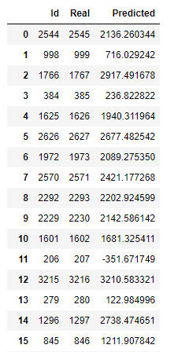
Result of Multiple Regression
Expectation:
Model to output an ID to be evicted in case of a miss in the cache.
Observation:
Multiple regression being a supervised learning algorithm, we pass the ID as one of the label for training. As a result, the model was trained to give us id’s closest to the input id values.

Slide 24
Reinforcement Learning
It is a subset of Artificial Intelligence in which the model takes actions to maximise rewards
Using Q-learning algorithm
Goal: Reduce miss rate

Slide 25

Concept behind Q-tables
Markov Decision Process is a bedrock for reinforcement learning. It give us a way to formalize sequential decision making.
Components of an MDP:
Agent, Environment, State, Action, Reward.
In MDP, state S, actions A, rewards R. We can have reward as an arbitrary function f that maps state-action pair to rewards. At each time t, we have
Notes:
This formalization is the basis for structuring problems that are solved with reinforcement learning.
In an MDP, we have a decision maker, called an agent, that interacts with the environment it's placed in. These interactions occur sequentially over time. At each time step, the agent will get some representation of the environment's state. Given this representation, the agent selects an action to take. The environment is then transitioned into a new state, and the agent is given a reward as a consequence of the previous action.
Throughout this process, it is the agent's goal to maximize the total amount of rewards that it receives from taking actions in given states

Slide 26
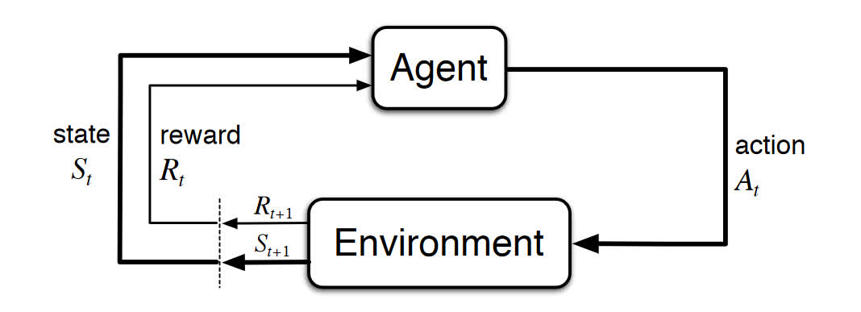
State Diagram

Slide 27
RL BLOCK DIAGRAM
REQUESTED
PAGE
HIT
MISS
SPACE AVAILABLE IN CACHE
SPACE UNAVAILABLE IN CACHE
Extra reward- high frequency + large size
Else base reward
ADD PAGE
REMOVE PAGE WITH MINIMUM VALUE AND ADD PAGE
REMOVE RANDOM PAGE AND ADD NEW PAGE
UPDATE Q-TABLE
COMPUTE HIT-RATE
Notes:
Initialise- size of cache, number of requests, reward value, learning rate and the cache
Q-table: maintains record of all the values present in the cache. Initialise the dimensions of q-table and update it periodically
Check if requested page is in cache, update counter:
Page is present-> Action is a HIT, increment hit counter
If page is requested many times-> high frequency and size of requested page is large, add extra reward
Else give base reward
Page is not present-> Action is a Miss and decrease the reward value
Add the page in cache if space is available
If previously stored pages in cache is present in q-table, remove the page with minimum value and add new page in its location
Else randomly remove a page in cache and add new page in its location
Update q-table with values in cache if counter value= size of cache
Update the values for the requested page in q-table if action was a HIT
Else update values of previous pages present in cache, stored in q-table
Compute hit rate

Slide 28
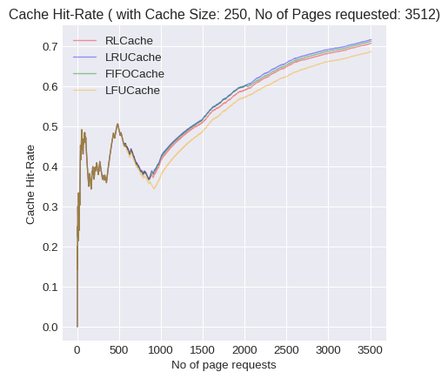
RESULTS
Without outliers

Slide 29
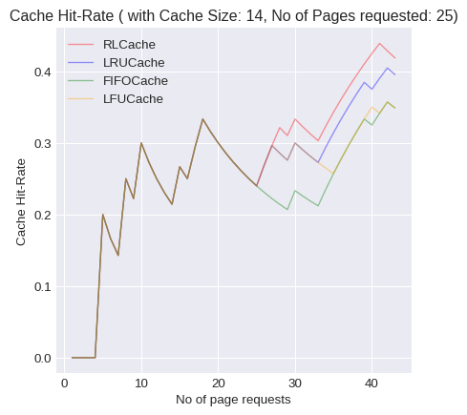
2 . With Outliers

Slide 30
CONCLUSION
We observed the performance of caching algorithms on FTP and HTTP packets from which we can conclude that our dataset is suitable for small size caches.
MLP was giving a very high hit rate due to small size of dataset and was over-fitting while Multiple Regression was predicting an id when real id was given as input instead of evicting id’s when cache was full.
Using supervised or unsupervised algorithms for classification or popularity prediction along with standard caching algorithm adds an overhead.
Notes:
We collected HTTP, FTP and video packets .
We observed the performance of caching algorithms on our updated dataset from which we can conclude that our dataset is suitable for small size caches.
We applied MLP and Multiple Regression to our updated dataset. We observed that both the algorithms was not giving us the output which was expected since MLP was giving a very high hit rate due to small size of dataset and over-fitting while Multiple Regression was predicting an id when real id was given as input instead of evicting id’s when cache was full.
So since supervise and unsupervise was not working.We went for reinforcement learning model for our project.

Slide 31
So, the algorithm most suitable for our project is Reinforcement Learning(RL). RL has the ability to learn and adapt to the environment. We have used Q-tables, which is a way to implement RL.
Applying RL for huge files FTP along with HTTP request packets is used to compensate the computational time and cost involved.
Thus we can conclude that the RL along with parameters like unique id, frequency and size for caching was a novel technique and its performance was comparable to the other algorithms more commonly used.
Notes:
On comparing the results of RL with algorithms like LRU, LFU and FIFO we noticed that without outliers present in the data the performance of RL is similar to that of LRU and FIFO algorithms with a hit rate of nearly 0.7. With outliers present in the data, we noticed that RL performs better than the rest of the algorithms.
Thus we can conclude that the algorithm we used using unique id’s along with additional parameters like frequency and size for caching was a novel technique and its performance was comparable to the other algorithms more commonly used.

Slide 32
GANTT CHART
SEPTEMBER
OCTOBER
NOVEMBER
Completion of reading papers
and Data collection
Data Collection and Pre- processing of data
Testing different caching algorithms and MLP
Collecting more dataset
Research on FTP request packets

Slide 33
GANTT CHART
JANUARY
FEBRUARY
MARCH
APRIL
EXTRACTING FTP REQUEST
PRE- PROCESSING AND VISUALIZING DATASET
ANALYSING DIFFERENT MODELS- MLP, MULTIPLE REGRESSION
IMPLEMENTING RL AND CONCLUDING PROJECT

Slide 34
References
[1] Z. Chang, L. Lei, Z. Zhou, S. Mao and T. Ristaniemi, "Learn to Cache: Machine Learning for Network Edge
Caching in the Big Data Era," in IEEE Wireless Communications, vol. 25, no. 3, pp. 28-35, JUNE 2018, doi:
10.1109/MWC.2018.1700317.
[2] P. Yang, N. Zhang, S. Zhang, L. Yu, J. Zhang and X. Shen, "Content Popularity Prediction Towards Location-Aware
Mobile Edge Caching," in IEEE Transactions on Multimedia, vol. 21, no. 4, pp. 915-929, April 2019,
doi:10.1109/TMM.2018.2870521.
[3] C. Koch, S. Werner, A. Rizk and R. Steinmetz, "MIRA: Proactive Music Video Caching Using ConvNet-Based
Classification and Multivariate Popularity Prediction," 2018 IEEE 26th International Symposium on Modeling,
Analysis, and Simulation of Computer and Telecommunication Systems (MASCOTS), Milwaukee, WI, 2018, pp.
109-115, doi:10.1109/MASCOTS.201800019.
[4] Robert Gibb, https://blog.stackpath.com/web-cache/, June 2016.
[5] Vikas Solegaonkar, ”https://towardsdatascience.com/introduction-to-py-torch-13189fb30cb3”, 2019.
[6] YilinHan, Mengxuan Lyu, https://github.com/ShawnLYU/Optimizing-LeCar-and-Convolutional-Neural-Network-
Approaches-for-Cache-Replacement-Policy/blob/master/report/csc2233.pdf, 2019.
[7] Cisco Networking Academy,
https://static-course-assets.s3.amazonaws.com/IntroNet50ENU/files/7.2.4.3%20Lab%20-%20
Using%20Wireshark%20to%20Examine%20FTP%20and%20TFTP%20Captures.pdf, 2013.

Slide 35
[8] A. Sadeghi, G. Wang and G. B. Giannakis, "Deep Reinforcement Learning for Adaptive Caching in Hierarchical
Content Delivery Networks," in IEEE Transactions on Cognitive Communications and Networking, vol. 5, no. 4,
pp. 1024-1033, Dec. 2019, doi: 10.1109/TCCN.2019.2936193.
[9] Arti Singh, Rohit Kumar, https://github.com/artisingh0913/cache_replacement_policy_using_RL,
May 17th, 2020.
[10] Zhenyu Song, Fei Gao, Qizhe Cai,
https://medium.com/princeton-systems-course/sushi-a-machine-learning-based-cache-algorithm-23f5f11dc8b,
February 10th, 2019.
[11] Shanika Perera,
https://towardsdatascience.com/an-introduction-to-reinforcement-learning-1e7825c60bbe, August 21, 2019.
[12] Peter Grant, https://towardsdatascience.com/understanding-multiple-regression-249b16bde83e,
August 8th, 2019.
[13] W3Schools, https://www.w3schools.com/python/python_ml_multiple_regression.asp

Slide 36
THANK YOU...
Notes:
after objective Suggestion from feasiibility ppt = suggestion from the previous ppt completed
objective of the project
add grant chart
add references
make block diagram
change future scope name
make block diagram for algorithm

Slide 37
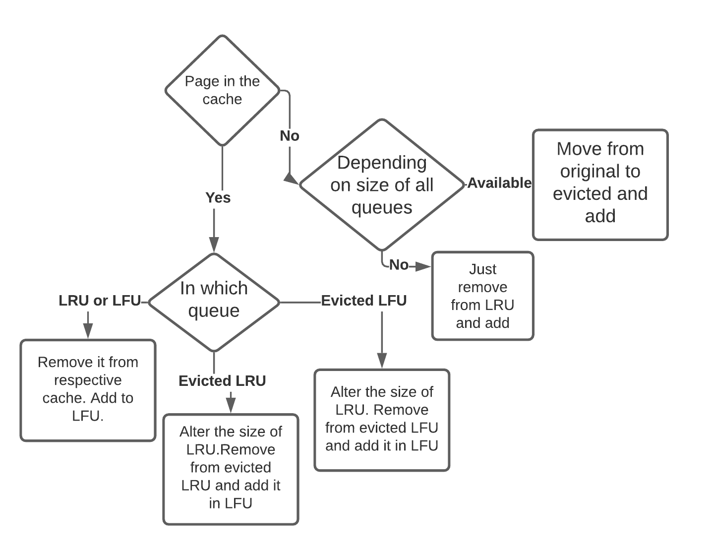
Notes:
Algorithm has one cache size defined by the user and it creates four queues for keeping the track and one set as a cache. Hits and miss are calculated accordingly.
Steps:
1) Page in LRU or LFU.
2) Page in evicted LRU.
3) Page in evicted LFU.
4) Page not in any of the four queues.
Adaptive replacement Algorithm (ARC):
1) It considers LRU, LFU, Evicted LRU and Evicted LFU.
2) If item in LRU or LFU, remove it from respective cache and add it in LFU. Increase hit count.
3) If item in evicted LRU: Alter the size of recency cache size, remove from evicted LRU and add it in LFU. Add it in cache and increase miss count.
4) If item in evicted LFU, alter recency cache size, remove from evicted LFU and add it in LFU. Increase the miss count.
5) If new item: if size of LRU+evicted LRU=cache size
If(recency<cache):
Remove item from evicted recency and add one item from recency to gost recency.
Else:
Just remove item from recency.
If(r+g.r>cache size and sum of all> cach size):
If(sum=2*cache):
Pop from ghost_frequency.
Add from freq to ghost frequency.
Remove from cache.

Slide 38
INFERENCE
Supervised Learning Algorithms
We don’t have a labeled dataset
Supervised models are mainly used for regression and classification problem.
But for our project, output id to be evicted is chosen based not only on input data but on the available space in cache also.
Also using supervised or unsupervised for classification or popularity prediction along with standard caching algorithm adds an overhead.
UnSupervised Learning Algorithm
Unsupervised learning are mostly used for clustering, representation learning, and density estimation.
As in all of these cases, we wish to learn the inherent structure of our data without using explicitly - provided labels.
But for our project we don’t have to do any of these.
Notes:
Why we can’t use supervised learning algorithm for our project ?
Based on various input parameters ,and the given size of cache , tell us which to evict .
Supervised models are mainly used for regression and classification problem, the goal is to find specific relationships or structure in the input data that allow us to effectively produce correct output data.
for supervised :
Tried on : Multiple regression and random forest
We tried these two algorithms in our dataset and understood that we can’t use supervised learning approach
Supervised models are mainly used for regression and classification problem, the goal is to find specific relationships or structure in the input data that allow us to effectively produce correct output data

Slide 39
Methodology
Preprocessed dataset is run on different caching algorithms in order to understand its behaviour.
We tested the performance of our dataset on the following ML Algorithms: Multiple Regression, MLP and RL
The best ML algorithm will be optimised to reach better hit rate than the standard caching algorithms
Notes:
● Gathering the dataset from different types of servers belonging to the same LAN.
● Pre-processing this data into the required format.
● Preprocessed dataset is run on different caching algorithms like LRU, LFU, OPT, ARC and LeCar in order to understand its behaviour.
● Selecting the appropriate features to train the model.
● The performance of our dataset on the following ML Algorithms: MLP, CNN, Decision Tree will be compared.
● The best combination of ML algorithm will be optimized to reach similar or better hit rate than the standard caching algorithms.
● Gathering the dataset from different types of servers belonging to the same LAN.
● Pre-processing this data into the required format.
● Preprocessed dataset is run on different caching algorithms like LRU, LFU, OPT, ARC and LeCar in order to understand its behaviour.
● Selecting the appropriate features to train the model.
● The performance of our dataset on the following ML Algorithms: MLP, CNN, Decision Tree will be compared.
● The best combination of ML algorithm will be optimized to reach similar or better hit rate than the standard caching algorithms.

